Slide 1


Hierarchal Clustering

Slide 2
Hierarchal Clustering
Hierarchical clustering
Build a hierarchy of clusters.
Unlike other clustering methods (like k-means, which requires specifying the number of clusters in advance)
Hierarchical clustering automatically creates a structure in which clusters are successively nested within each other.

Slide 3











Point | Feature 1 | Feature 2
A | 1 | 1
B | 2 | 1
C | 4 | 3
D | 5 | 4
E | 3 | 5
Hierarchal Clustering
Step 1: Calculate Pairwise Distances
$$d(A,B)=\sqrt{{({F1}_{B}−{F1}_{A})}^{2}+{({F2}_{B}−{F2}_{A})}^{2}}$$
$d\left(A,B\right)=$1
$$d\left(B,D\right)=4.242$$
$$d\left(A,C\right)=3.605$$
$$d\left(B,E\right)=4.123$$
 | A | B | C | D | E
A | 0 | 1 | 3.605 | 5 | 4.472
B | 1 | 0 | 2.828 | 4.242 | 4.123
C | 3.605 | 2.828 | 0 | 1.414 | 2.236
D | 5 | 4.242 | 1.414 | 0 | 2.236
E | 4.472 | 4.123 | 2.236 | 2.236 | 0
$$d\left(A,D\right)=5$$
$$d\left(C,D\right)=1.414$$
$$d\left(A,E\right)=4.472$$
$$d\left(C,E\right)=2.236$$
$$d\left(B,C\right)=2.828$$
$$d\left(D,E\right)=2.236$$
A
B
C
D
E

Slide 4





 | A | B | C | D | E
A | 0 | 1 | 3.605 | 5 | 4.472
B | 1 | 0 | 2.828 | 4.242 | 4.123
C | 3.605 | 2.828 | 0 | 1.414 | 2.236
D | 5 | 4.242 | 1.414 | 0 | 2.236
E | 4.472 | 4.123 | 2.236 | 2.236 | 0
Hierarchal Clustering
Step 2: Start Clustering (Single Linkage)
2.1) Initial step: Each point is its own cluster. We start with the clusters:
$\left\{A\right\}, \left\{B\right\},\left\{C\right\}, \left\{D\right\},$ $\left\{E\right\}$
2.2) Find the closest pair of clusters: The closest pair is A and B with a distance of 1. Merge them into one cluster
$\left\{A,B\right\},\left\{C\right\}, \left\{D\right\},$ $\left\{E\right\}$
 | {A, B} | C | D | E
{A, B} | 0 | 2.828 | 4.242 | 4.123
C | 2.828 | 0 | 1.414 | 2.236
D | 4.242 | 1.414 | 0 | 2.236
E | 4.123 | 2.236 | 2.236 | 0
Update the distance matrix by keeping the minimum distance between the new cluster and all other clusters (single linkage):
Distance between $\left\{A,B\right\} \& \left\{C\right\}$
$$Min (d\left(A,C\right),d\left(B,C\right)=\text{M}\text{in}\text{(3.605, 2.828) = }\text{2.828}$$
Distance between $\left\{A,B\right\} \& \left\{D\right\}$
$$Min (d\left(A,D\right),d\left(B,D\right)=\text{M}\text{in}\text{(5, 4.242) = }\text{4.242}$$
Distance between $\left\{A,B\right\} \& \left\{E\right\}$
$$Min (d\left(A,D\right),d\left(B,D\right)=\text{M}\text{in}\text{(4.472, 4.123) = }\text{4.123}$$
A
B
C
D
E

Slide 5



Hierarchal Clustering
 | {A, B} | C | D | E
{A, B} | 0 | 2.828 | 4.242 | 4.123
C | 2.828 | 0 | 1.414 | 2.236
D | 4.242 | 1.414 | 0 | 2.236
E | 4.123 | 2.236 | 2.236 | 0
Step 2: Start Clustering (Single Linkage)
2.3) Find the closest pair of clusters: The closest pair is A and B with a distance of 1. Merge them into one cluster
$$\left\{A,B\right\},\left\{C,D\right\}, \left\{E\right\}$$
 | {A, B} | {C, D} | E
{A, B} | 0 | 2.828 | 4.123
{C, D} | 2.828 | 0 | 2.236
E | 4.123 | 2.236 | 0
Update the distance matrix by keeping the minimum distance between the new cluster and all other clusters (single linkage):
Distance between $\left\{C,D\right\} \& \left\{A,B\right\}$
$$\text{M}\text{in}\text{( }\text{d}\text{(}\text{C}\text{, }\text{A}\text{, }\text{B}\text{), }\text{d}\text{(}\text{D}\text{, }\text{A}\text{, }\text{B}\text{)) = }\text{Min}\text{(2.828, 4.242) = }\text{2.828}$$
Distance between $\left\{C,D\right\} \& \left\{E\right\}$
$$\text{M}\text{in} \text{(} \text{d}\text{(}\text{C}\text{, }\text{E}\text{), }\text{d}\text{(}\text{D}\text{, }\text{E}\text{)) = }\text{M}\text{in}\text{(2.236, 2.236) = }\text{2.236}$$
A
B
C
D
E

Slide 6


Hierarchal Clustering
 | {A, B} | {C, D} | E
{A, B} | 0 | 2.828 | 4.123
{C, D} | 2.828 | 0 | 2.236
E | 4.123 | 2.236 | 0
Step 2: Start Clustering (Single Linkage)
2.4) Find the closest pair of clusters: The next closest pair is C, D and E with a distance of 2.236. We merge them:
$$\left\{A,B\right\},\left\{C,D,E\right\}$$
 | {A, B} | {C, D, E}
{A, B} | 0 | 2.828
{C, D, E} | 2.828 | 0
Update the distance matrix by keeping the minimum distance between the new cluster and all other clusters (single linkage):
Distance between $\left\{C,D,E\right\} \& \left\{A,B\right\}$
$$\text{M}\text{in}\text{(}\text{d}\text{(}\text{C}\text{, }\text{D}\text{, }\text{E}\text{), }\text{d}\text{(}\text{A}\text{, }\text{B}\text{)) = }\text{M}\text{in}\text{(2.828, 4.123) = }\text{2.828}$$
A
B
C
D
E

Slide 9
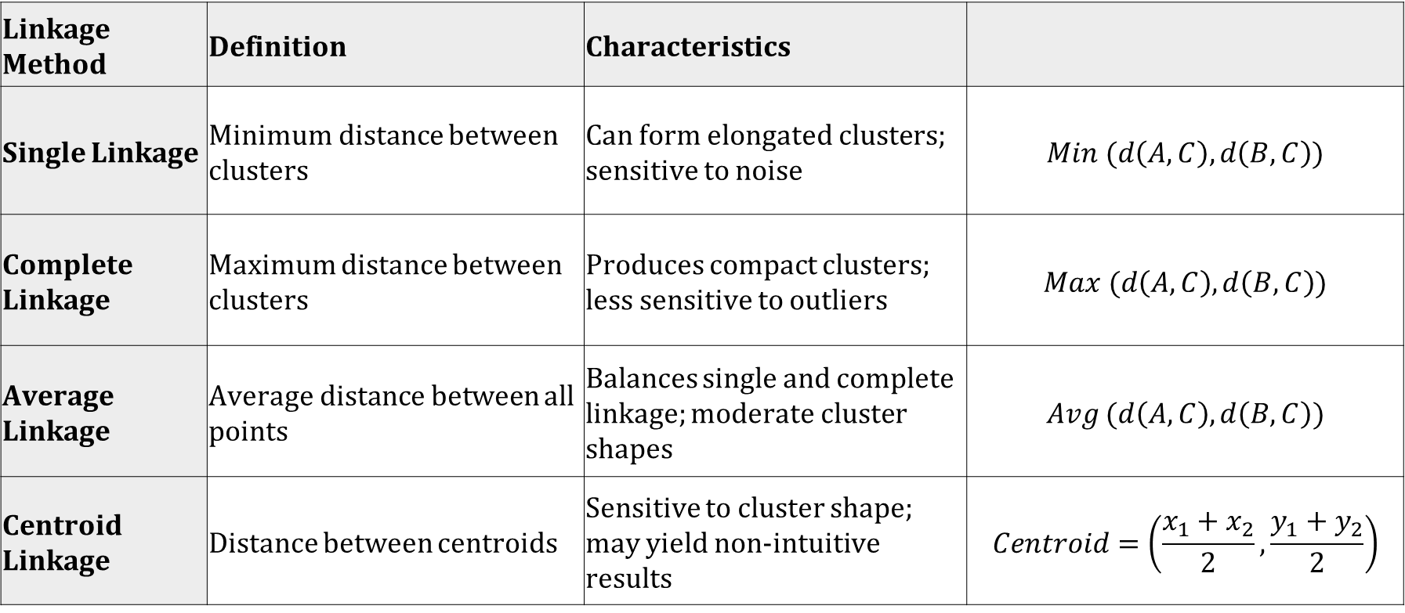
Hierarchal Clustering
Linkage Method | Definition | Characteristics
Single Linkage | Minimum distance between clusters | Can form elongated clusters; sensitive to noise | $$Min (d\left(A,C\right),d\left(B,C\right))$$
Complete Linkage | Maximum distance between clusters | Produces compact clusters; less sensitive to outliers | $$Max (d\left(A,C\right),d\left(B,C\right))$$
Average Linkage | Average distance between all points | Balances single and complete linkage; moderate cluster shapes | $$Avg (d\left(A,C\right),d\left(B,C\right))$$
Centroid Linkage | Distance between centroids | Sensitive to cluster shape; may yield non-intuitive results | $$Centroid=\left(\frac{x_{1}+x_{2}}{2},\frac{y_{1}+y_{2}}{2}\right)$$

Slide 10
Hierarchal Clustering
Hierarchical structure is needed: Useful for building nested groupings, like taxonomy (e.g., species into genera).
Unknown number of clusters: No need to predefine the number of clusters; use the dendrogram to decide.
Visualizing cluster relationships: Dendrogram provides a clear visualization of how clusters form at different levels.
Small to medium-sized datasets: Suitable for datasets with a few hundred points due to computational complexity.
Clusters of varying shapes and sizes: Handles irregular, non-spherical clusters better than methods like k-means.
When outliers are not a concern: Sensitive to outliers, so should be used when data is relatively clean.

Slide 11
Comparative Analysis
Feature | DBSCAN | Hierarchical Clustering | K-Means
Cluster Shape | Arbitrary-shaped clusters | Handles clusters of various shapes | Spherical or circular clusters
Number of Clusters | Automatically determined | No need to predefine | Must be specified in advance
Scalability | Efficient with large datasets | Best for small to medium datasets | Efficient for large datasets
Handling Outliers | Identifies and separates outliers | Sensitive to outliers | Sensitive to outliers
Distance Metric | Based on neighborhood radius (ε) | Flexible (various linkage types) | Based on Euclidean distance
Parameters | ε (radius) and minPts (min points) | No parameters required initially | k (number of clusters)
Data Size | Large datasets | Small to medium datasets | Large datasets
Cluster Size | Handles clusters of different sizes | Can handle clusters of different sizes | Tends to form clusters of similar size
Handling Noise | Can effectively separate noise | Less robust to noise | Poor handling of noise
Initialization | No random initialization | No random initialization | Randomly initializes centroids

Slide 14
Thank You

